Slide 1
Malicious Web Content Detection using Machine Learning
CAPSTONE PROJECT
Presented By:
Nivedha P M – Aalim Muhammed Salegh College Engineering – B.E. Computer Science and Engineering

Slide 2
OUTLINE
Problem Statement (Should not include solution)
Proposed System/Solution
System Development Approach (Technology Used)
Algorithm & Deployment
Result (Output Image)
Conclusion
Future Scope
References

Slide 3
Problem Statement
Naive web browser users are vulnerable to online threats such as phishing scams and malware downloads because they lack awareness of the website's back-end functionalities. This can lead to them unknowingly giving away personal information or downloading malicious content. Exhaustively identifying and blocking all harmful content is impossible due to its constant evolution.

Slide 4
Proposed Solution
This project proposes a Chrome extension that acts as a middleware between users and websites. The extension utilizes machine learning to:
Mitigate risks from malicious websites: The extension will identify and block potential threats like phishing attempts and malware downloads.
Adapt to evolving threats: By employing machine learning, the extension will be able to categorize new and unseen content, enabling it to take appropriate actions against emerging threats.
This approach aims to empower users by providing an additional layer of protection against online dangers, even when encountering previously unknown malicious content.

Slide 5
System Approach
Machine Learning Algorithms
1. Support Vector Machines (SVMs): Effective for identifying patterns in high-dimensional data.
2. Random Forests: Robust to noise and capable of handling various data types.
3. Deep Learning models : Powerful for complex feature extraction and classification
Chrome Extension Development Tools -web APIs

Slide 6
Algorithm & Deployment
1. Data Collection and Preprocessing:
Textual content from the website (analyzing keywords, phrases, or suspicious language patterns).
Visual elements like image content or unusual layouts.
Website structure and code analysis (looking for hidden elements or suspicious redirects).
Cleaning and formatting the text data.
Extracting relevant features from images or website structure.
Splitting the data into training and testing sets.
2. Machine Learning Model Training:
Support Vector Machines (SVMs): Effective for identifying patterns in high-dimensional data.
Random Forests: Robust to noise and capable of handling various data types.
Deep Learning models : Powerful for complex feature extraction and classification.
Train the chosen model on the labeled dataset (where websites are categorized as malicious or benign).

Slide 7
3. Website Classification During Operation:
When a user visits a website:
The extension extracts relevant features from the website's content, structure, and code.
The extracted features are fed into the trained machine learning model.
The model predicts whether the website is likely to be malicious.
4. Action Based on Prediction:
If the model predicts a malicious website:
The user is warned about potential risks.
Depending on the risk level, the extension might block access to the website altogether.
If the model predicts a benign website:
The user can continue browsing normally.
5. Model Retraining and Improvement:
Continuously monitor the extension's performance and gather feedback from users.
Update the training dataset with new website examples, especially those identified as malicious after initial deployment.
Retrain the machine learning model periodically to improve its accuracy in detecting evolving threats.

Slide 8
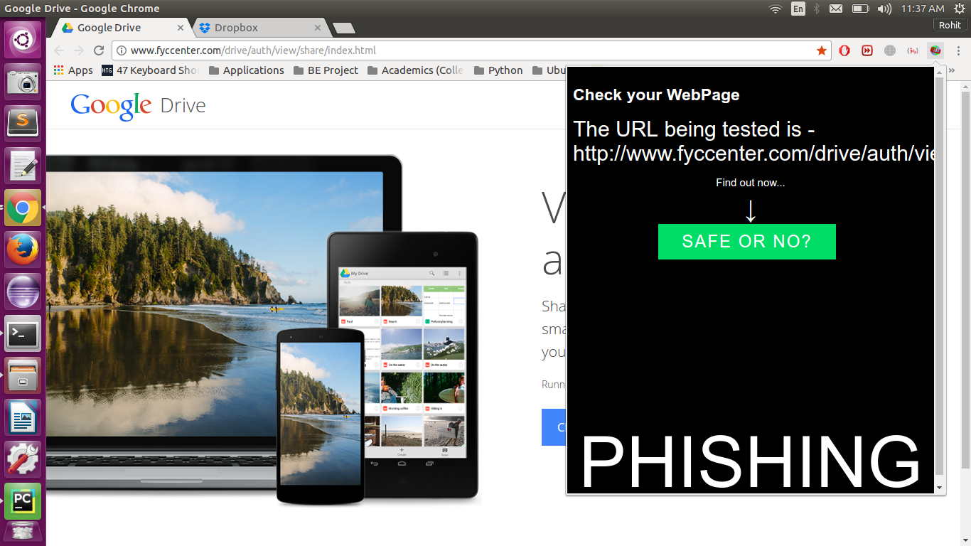
Result

Slide 9
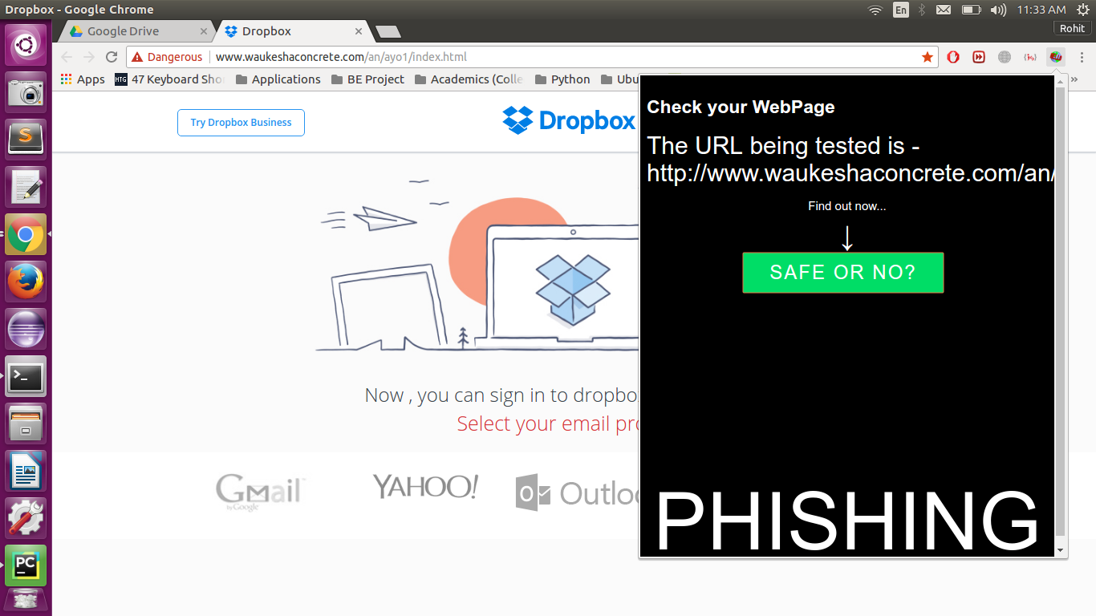
Result

Slide 10
Conclusion
Naive users using a browser have no idea about the back-end of the page. The users might be tricked into giving away their credentials or downloading malicious data.
Our aim is to create an extension for Chrome which will act as middleware between the users and the malicious websites, and mitigate the risk of users succumbing to such websites.
Further, all harmful content cannot be exhaustively collected as even that is bound to continuous development. To counter this we are using machine learning - to train the tool and categorize the new content it sees every time into the particular categories so that corresponding action can be taken.

Slide 11
Future scope
1. Enhanced Threat Detection:
Integrate with threat intelligence feeds to stay updated on the latest phishing techniques and malware signatures.
Explore advanced anomaly detection techniques to identify suspicious website behavior not explicitly present in the training data.
2. User Customization:
Allow users to adjust the risk tolerance level, influencing how aggressively the extension flags or blocks websites.
Provide users with more granular control over the types of information the extension analyzes (text, visuals, code).

Slide 12
3. Broader Protection:
Expand functionality beyond Chrome to encompass other popular web browsers.
Explore the possibility of integrating the extension with email clients or messaging platforms to identify and warn users about potential phishing attempts in those channels.
4. Multi-layered Defense:
Investigate incorporating additional security measures alongside machine learning, such as website reputation blacklists or real-time URL analysis.
5. User Education:
Develop informative pop-ups or notifications to educate users about the potential risks identified by the extension, fostering cybersecurity awareness.
6. Integration with Password Managers:
Explore the possibility of integrating with password managers to auto-fill login credentials only on verified safe websites.

Slide 13
References
Research paper - http://ieeexplore.ieee.org/document/8256834/

Slide 14
THANK YOU

